Slide 1
Agenda
1. Intro HTML
2. Intro CSS
3. RGB Color Model
4. Selectors
5. Box Models
6. Div Element
7. Float
8. Positioning
9. HTML Tree Structure
10. Web Design
11. Fonts
12. Colors
13. Images
14. Icons

Slide 2
1. Introduction to HTML
HTML: Hypertext Markup Language
HTML documents are described by HTML tags
<h1>
<p>
<a>
Tags mark up the beginning and the end of an element
<tagname>content</tagname>

Slide 3
2. Introduction to CSS
Cascading Style Sheets
CSS defines how HTML looks like
HTML is what
CSS is how

Slide 4
2. Introduction to CSS
3 Ways to import CSS
1. CSS code inside an HTML tag
2. CSS code inside an HTML document
3. CSS code in external file

Slide 5
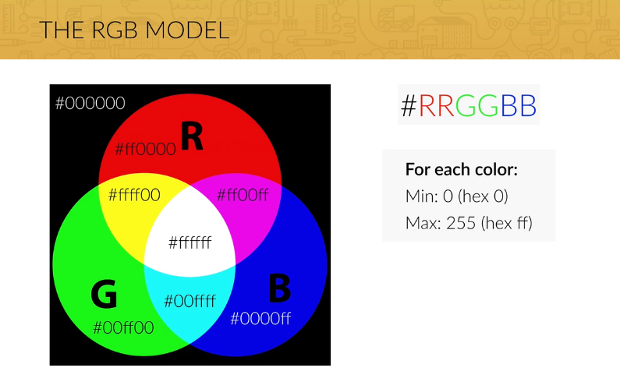
3. RGB Model

Slide 6
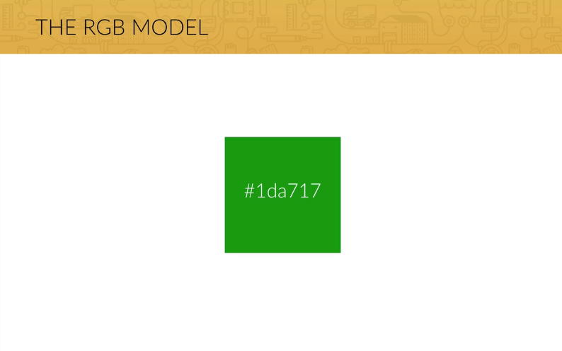
3. RGB Model

Slide 7
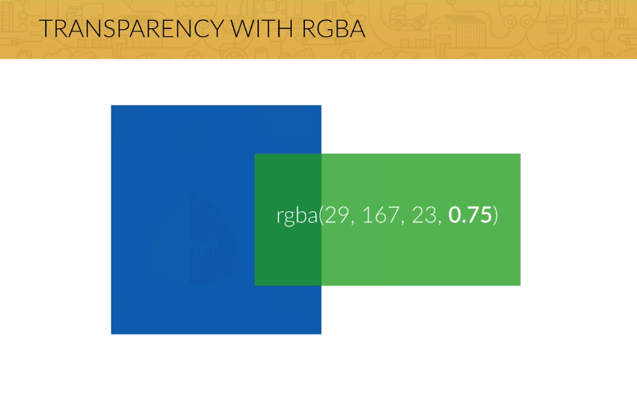
3. RGB Model

Slide 8
4. Selectors
Classes and IDs
Classes can refer to multiple HTML items
IDs can only refer to one HTML item

Slide 9
4. Selectors
Selector | Description
* | Selects all elements
.CLASSNAME | Selects all elements with a specific class = CLASSNAME
#IDNAME | Select one element with a specific id = IDNAME
TAG1 TAG2 | Selects all TAG2 elements which are children to TAG1 i.e. li a would give all anchor-tags within
TAG1 > TAG2 | Selects all TAG2 elements which are direct children to TAG1 i.e. li > a would give all anchor-tags within as
TAG.CLASSNAME | Selects all TAG elements which have the class CLASSNAME
TAG#IDNAME | Selects all TAG elements which have the class IDNAME
TAG1 + TAG2 | Selects the first adjacent TAG2 element after the TAG1 element

Slide 10
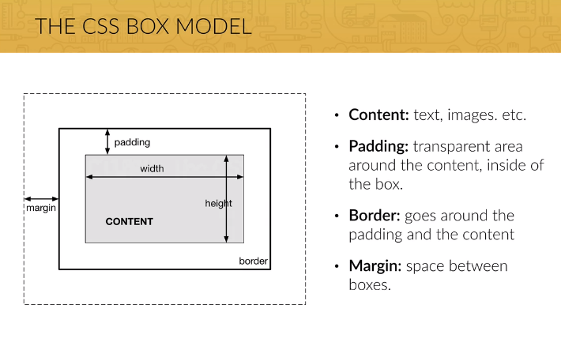
5. Box Model

Slide 11
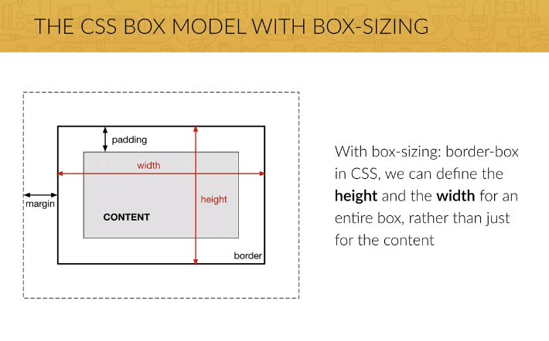
5. Box Model

Slide 12
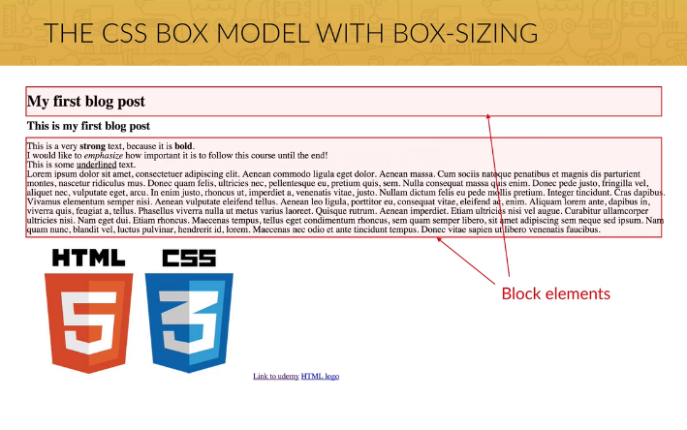
5. Box Model

Slide 13
5. Box Model
Two kinds of elements
Block: creates a line-break, uses full width of browser
H1, h2, p, ...
Inline: does not create a line-break, does not use full width of browser
strong, em, u, ...

Slide 14
6. DIV Element
DIV: most used element in websites
DIV stands for “divide”
Centering content:
Margin-left: auto
Margin-right: auto

Slide 15
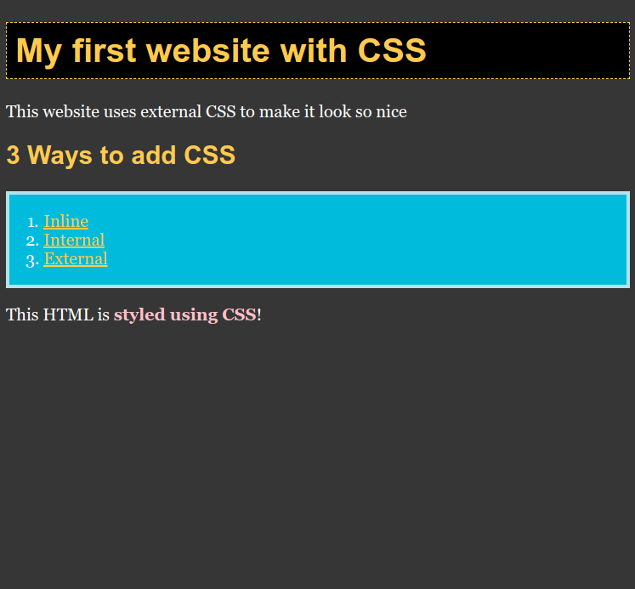
Task: Style the HTML elements that the index.html looks like this website:
#ffcc33
#bce3ed
#33bcde
pink
#333

Slide 16
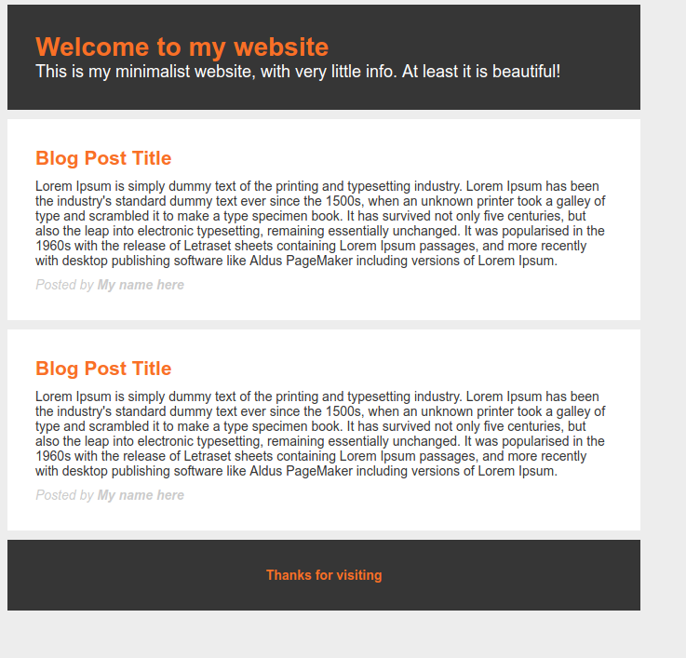
Task: Style the HTML elements that the index.html looks like this website:
#333
#ed700

Slide 17
6. Colors
GO
https://www.w3schools.com/colors/colors_names.asp
Colors can either have a RGB value or a HEX (Hexadecimal Value)
RGB – RED (0 – 255), GREEN (0-255), BLUE (0-255)
255 (3 decimal digits) = FF (2 hexadecimal digits)

Slide 18
6. Colors
Decimal System:
0,1,2,3,4,5,6,7,8,9
= 10 Digits
Hexadecimal System:
0,1,2,3,4,5,6,7,8,9,A,B,C,D,E,F
= 16 Digits
#FEFAFD
(almost white)

Slide 19
6. Colors
Task: What Color is: #9c12ee?
Calculate the RGB Value using a pen and a paper.
Try to guess what color it might be, without using the computer.
Decimal System:
0,1,2,3,4,5,6,7,8,9
= 10 Digits
Hexadecimal System:
0,1,2,3,4,5,6,7,8,9,A,B,C,D,E,F
= 16 Digits
#FEFAFD
(almost white)

Slide 20
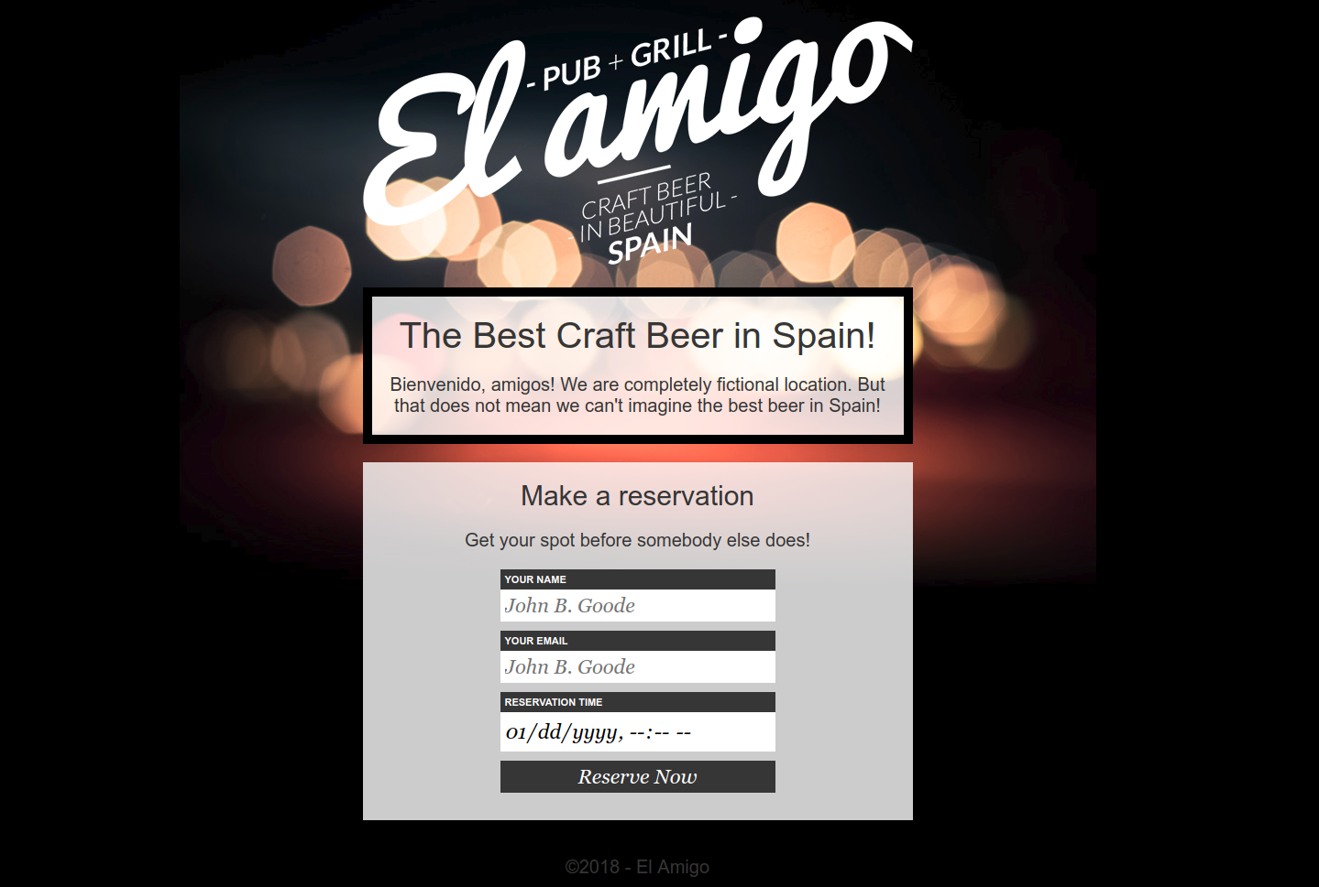
Task: Build a Styled Form
Pull the /task5 folder, take a look at the /images folder. There is all you need image-wise.
Code the index.html and styles.css using the following information and the lessons you have learned so far about background-images, styling forms and text-formatting

Slide 21
Task: Build a Styled Form
3 divs
wrapped in
an container div,
which is always
centered

Slide 22
Task: Build a Styled Form
logo.png
background.jpg
transparent_white.png

Slide 23
Task: Build a Styled Form
Input type = datetime-local

Slide 24
Task: Build a Styled Form
Helvetica Neue
Georgia

Slide 25
7. Float
A float is a box that is shifted to the left or right on the current line. The most interesting characteristic of a float (or “floated” or “floating” box) is that content may flow along its side (or be prohibited from doing so by the “clear” property). Content flows down the right side of a left-floated box and down the left side of a right-floated box.
Floating is used for building layouts.

Slide 26
7. Float
BLOCK ELEMENT
current line = 0
Normal Flow
=
Stacking
On top
of each other

Slide 27
7. Float
BLOCK ELEMENT
Normal Flow
=
Stacking
On top
of each other
BLOCK ELEMENT
current line = 1

Slide 28
7. Float
BLOCK ELEMENT
Normal Flow
=
Stacking
On top
of each other
BLOCK ELEMENT
BLOCK ELEMENT
current line = 2

Slide 29
7. Float
BLOCK ELEMENT
Normal Flow
=
Stacking
On top
of each other
BLOCK ELEMENT
BLOCK ELEMENT
current line = 2
FLOAT RIGHT
Float Flow (Right)

Slide 30
7. Float
BLOCK ELEMENT
Normal Flow
=
Stacking
On top
of each other
BLOCK ELEMENT
BLOCK ELEMENT
current line = 2
FLOAT RIGHT
FLOAT RIGHT
Float Flow (Right)

Slide 31
7. Float
BLOCK ELEMENT
Normal Flow
=
Stacking
On top
of each other
BLOCK ELEMENT
BLOCK ELEMENT
current line = 2
FLOAT LEFT
FLOAT RIGHT
FLOAT RIGHT
Float Flow (Left)

Slide 32
7. Float
BLOCK ELEMENT
Normal Flow
=
Stacking
On top
of each other
BLOCK ELEMENT
BLOCK ELEMENT
current line = 2
FLOAT LEFT
FLOAT LEFT
FLOAT RIGHT
FLOAT RIGHT
Float Flow (Left)

Slide 33
7. Float
BLOCK ELEMENT
Normal Flow
=
Stacking
On top
of each other
BLOCK ELEMENT
BLOCK ELEMENT
BLOCK ELEMENT
FLOAT LEFT
FLOAT LEFT
FLOAT RIGHT
FLOAT RIGHT
Float Flow (Left)
current line = 3

Slide 34
7. Float
Problem:
Floated elements are in the
Current line
-> Conflict
BLOCK ELEMENT
Normal Flow
=
Stacking
On top
of each other
BLOCK ELEMENT
BLOCK ELEMENT
BLOCK ELEMENT
FLOAT LEFT
FLOAT LEFT
FLOAT RIGHT
FLOAT RIGHT
Float Flow (Left)
current line = 3

Slide 35
7. Float
Solution:
Clearing Element
Sets current line to
Last current line + 2
BLOCK ELEMENT
Normal Flow
=
Stacking
On top
of each other
BLOCK ELEMENT
BLOCK ELEMENT
FLOAT LEFT
FLOAT LEFT
FLOAT RIGHT
FLOAT RIGHT
CLEAR ELEMENT
current line = 4

Slide 36
7. Float
https://www.youtube.com/watch?v=xara4Z1b18I

Slide 37
7. Float
Collapsing:
When a parent element that contains any number of
floated elements does not expand to completely
surround those elements in the way it would if the
elements were not floated.

Slide 38
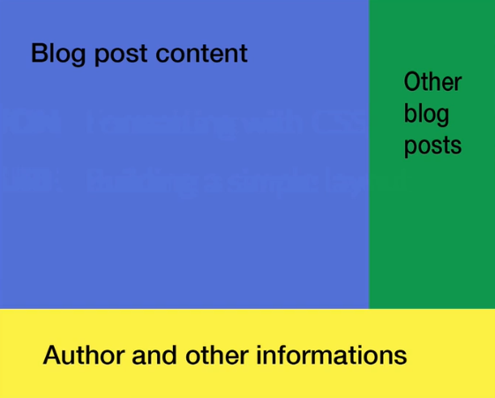

Slide 39
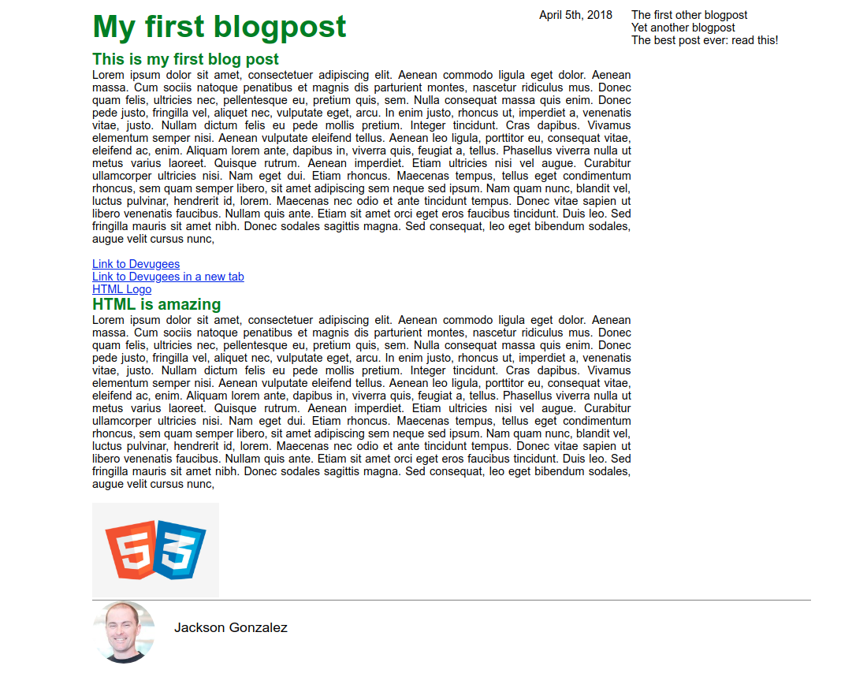
Task: Build the following floating layout

Slide 40
8. Positioning
Static (default value)
Appear as in the normal flow
Every element has “position: static” by default
Relative
Moves the element to the new position relative to the normal flow
Absolute
Moves the element to the new position relative to its first non-static positioned ancestor element,
Otherwise, the position of the body

Slide 41
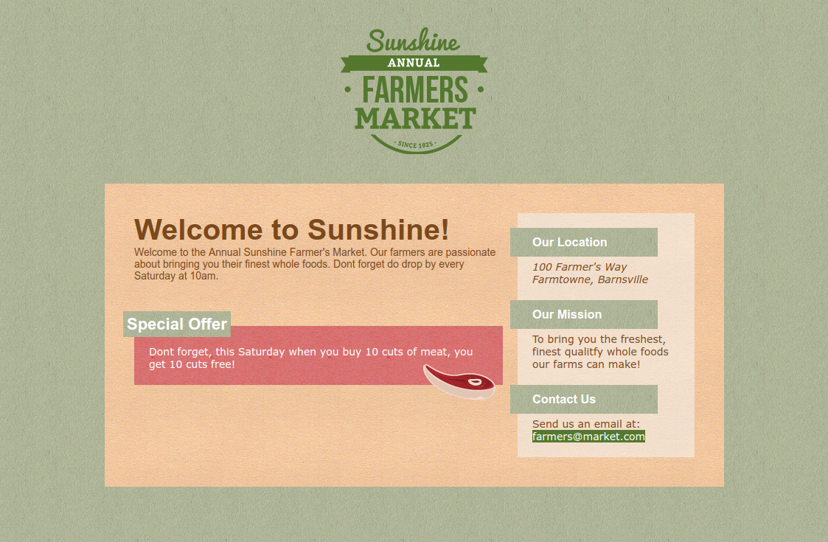
Task: Implement the Stylesheet

Slide 42
Task: Implement the Stylesheet
Use the following informations:
green_background.jpg
market_logo.png
steak.png
red_background.jpg
texture_background.jpg
yellow_background.jpg

Slide 43
Task: Implement the Stylesheet
Use the following informations:
#logo has width 200px
#container has width
760px
#main-content has width
500px and is floated
#sidebar has width
200px and is floated

Slide 44
Task: Implement the Stylesheet
Use the following informations:
relative positions
absolute position

Slide 45
Task: Implement the Stylesheet
Use the following informations:
All fonts Arial Helvetica

Slide 46
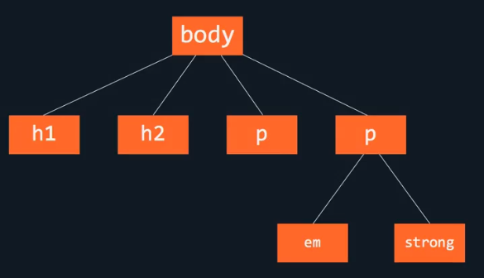
9. HTML Tree Structure

Slide 47
10. Web Design
The Designer creates the look and feel
The Developer builds it.

Slide 48
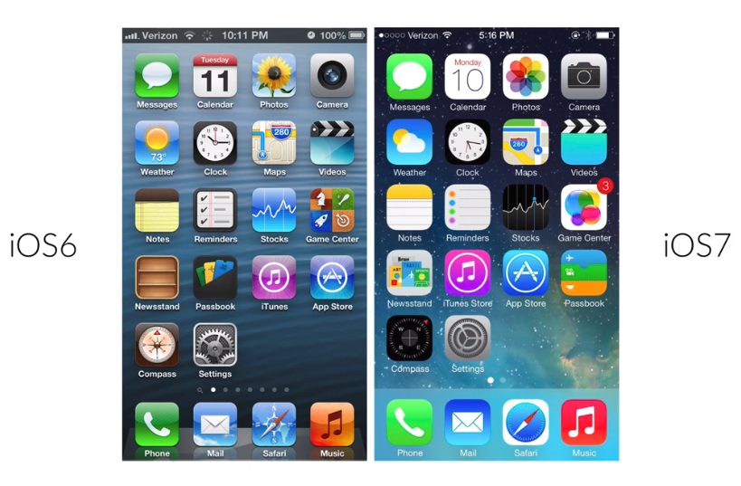
10. Designs

Slide 49
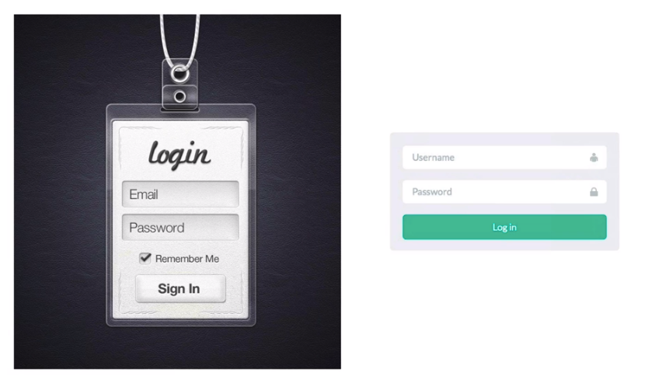
10. Designs

Slide 50

10. Designs

Slide 51
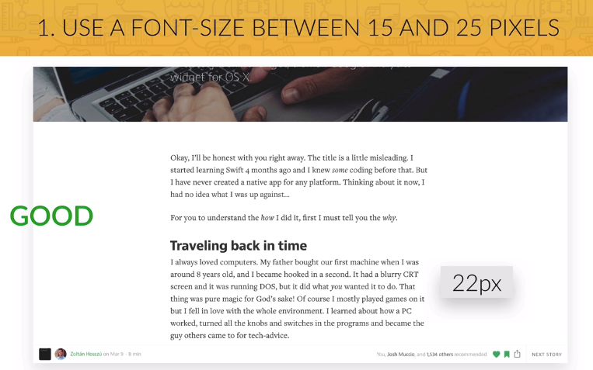
11. Fonts

Slide 52
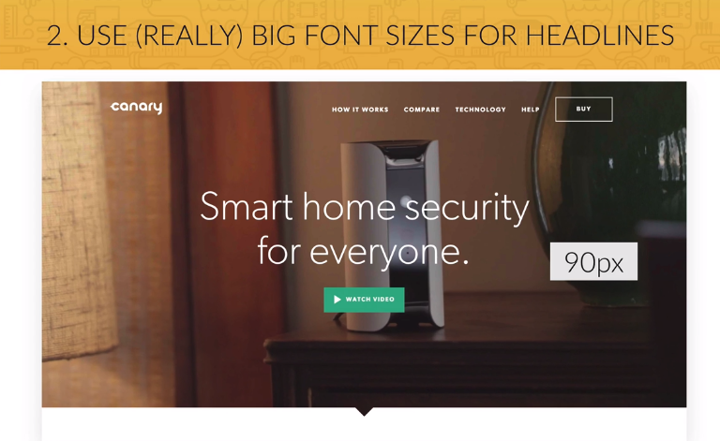
11. Fonts

Slide 53
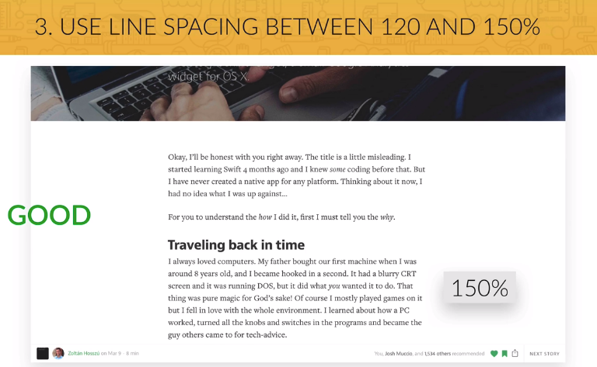
11. Fonts

Slide 54
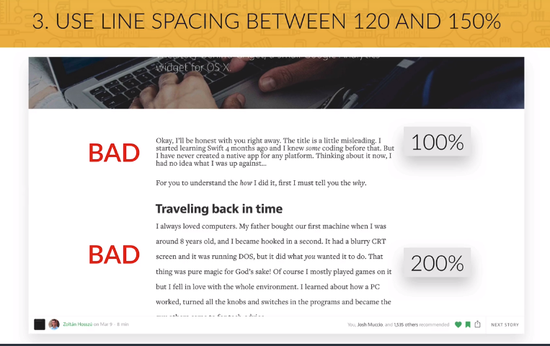
11. Fonts

Slide 55
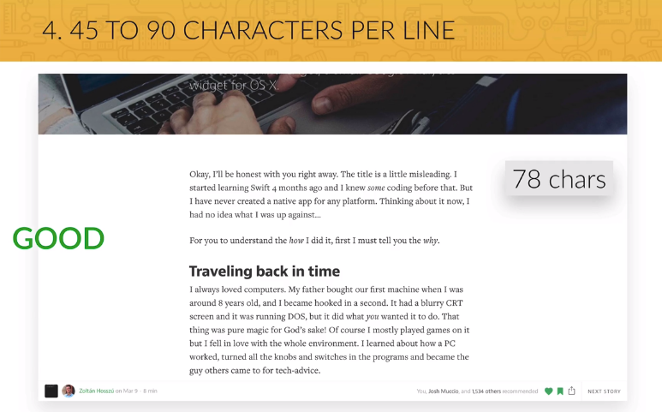
11. Fonts

Slide 56
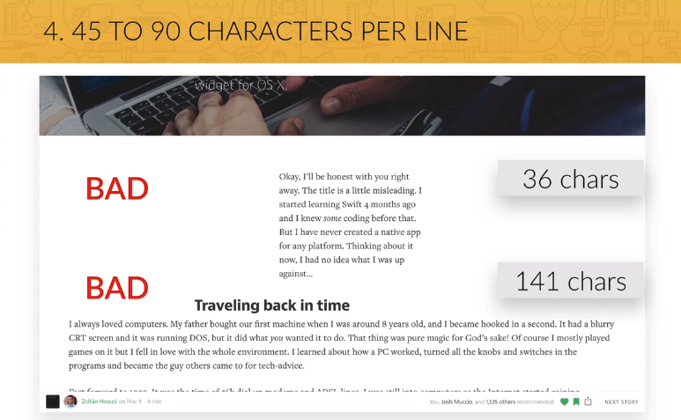
11. Fonts

Slide 57
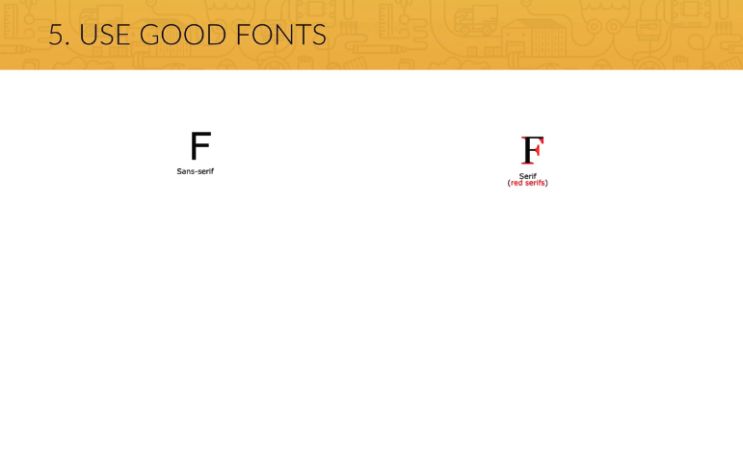
11. Fonts

Slide 58
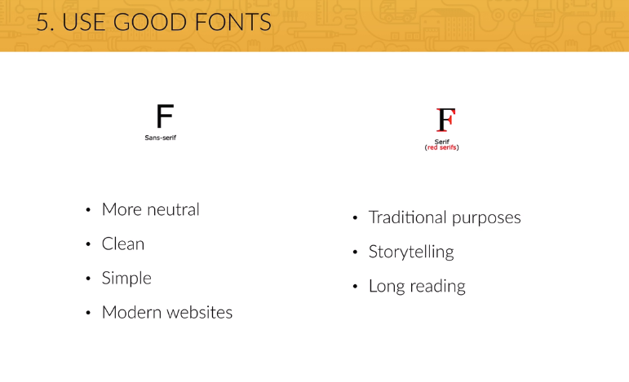
11. Fonts

Slide 59
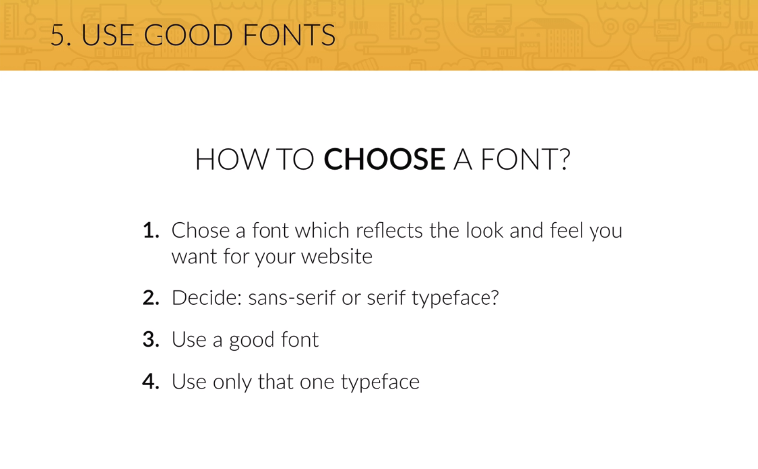
11. Fonts

Slide 60
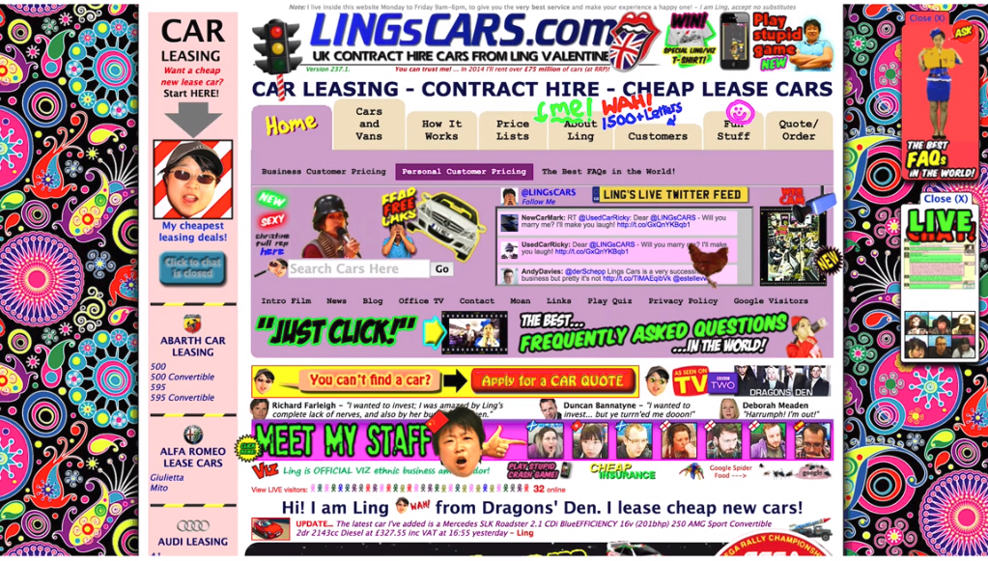
12. Colors

Slide 61
12. Colors
Picking a color for a website means more then picking your favorite color and turning it into a design. It means picking the right color in order to get the desired response from your audience. Color really makes a difference. This happens because there are psychological effects behind each color.

Slide 62
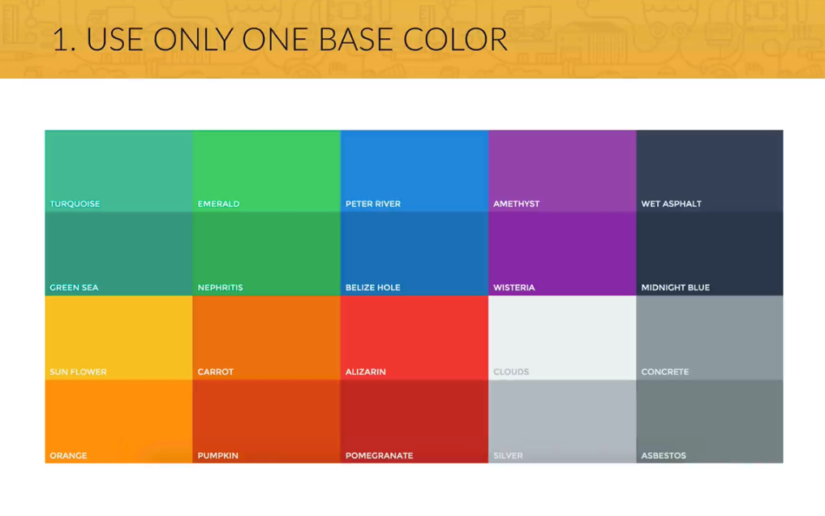
12. Colors

Slide 63
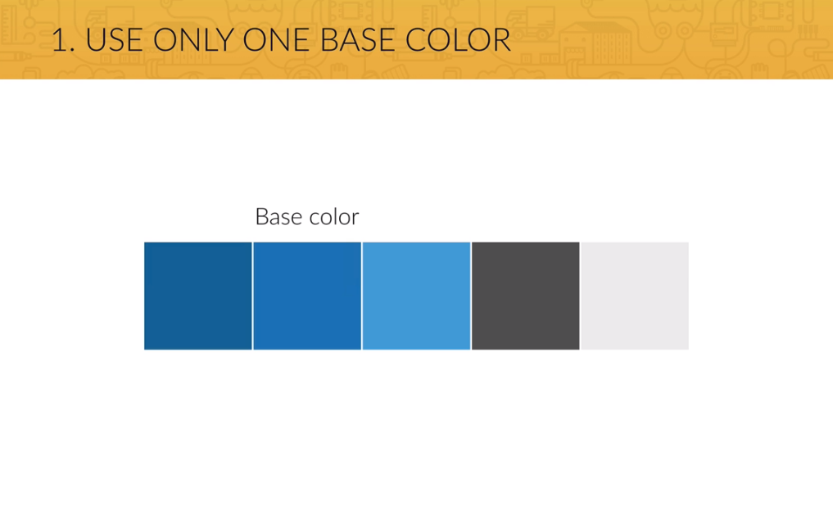
12. Colors

Slide 64

12. Colors

Slide 65
12. Colors
Red is a great color to use when power, passion, strength and excitement want to be transmitted. Brighter tones are more energetic and darker shades are more powerful and elegant.
Orange draws attention without being as overpowering as red. It means cheerfulness and creativity. Orange can be associated with friendliness, confidence, and courage.
Yellow is energetic and gives the feeling of happiness and liveliness. Also, it associates with curiosity, intelligence, brightness, etc.
Green is the color of harmony, nature, life and health. Also, it is often associated with money. In design, green can have a balancing and harmonizing effect.
Blue means patience, peace, trustworthiness, and stability. It is one of the most beloved colors, especially by men. It is associated with professionalism, trust and honor. That's actually why the biggest social networks use blue.
Purple is traditionally associated with power, nobility and wealth. In your design, purple can give a sense of wisdom, royalty, nobility, luxury, and mystery.
Pink expresses romance, passivity, care, peace, affection, etc.
Brown is the color of relaxation and confidence. Brown means earthiness, nature, durability, comfort, and reliability.

Slide 66
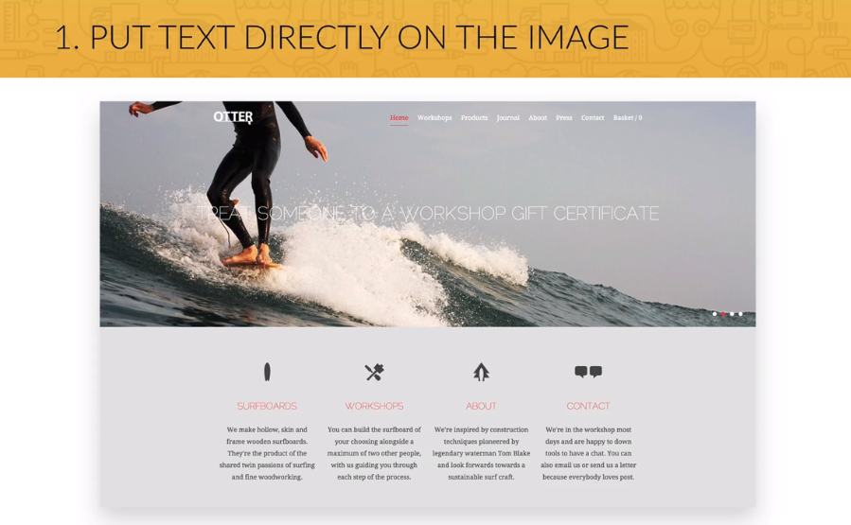
13. Images

Slide 67

13. Images

Slide 68

13. Images

Slide 69

13. Images

Slide 70
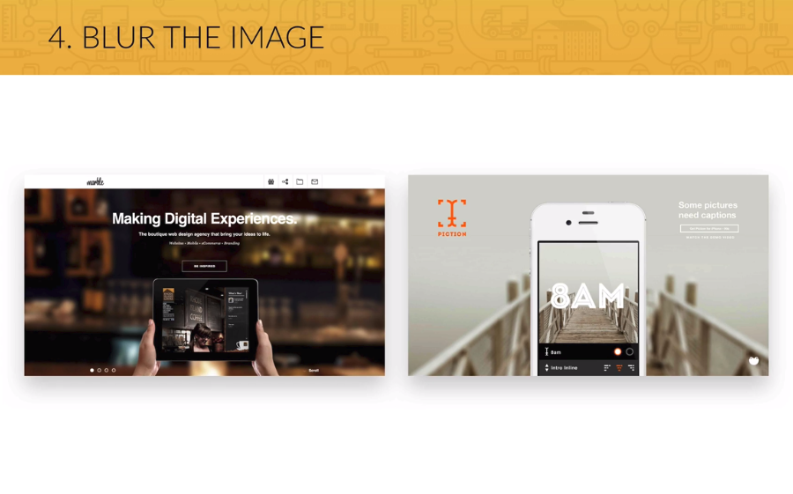
13. Images

Slide 71
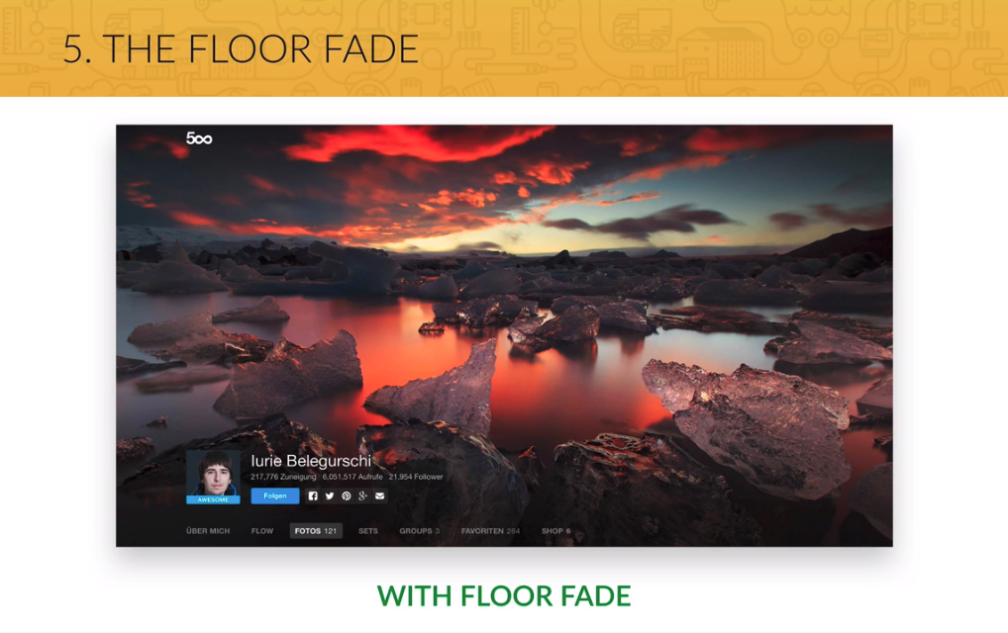
13. Images

Slide 72

14. Icons

Slide 73
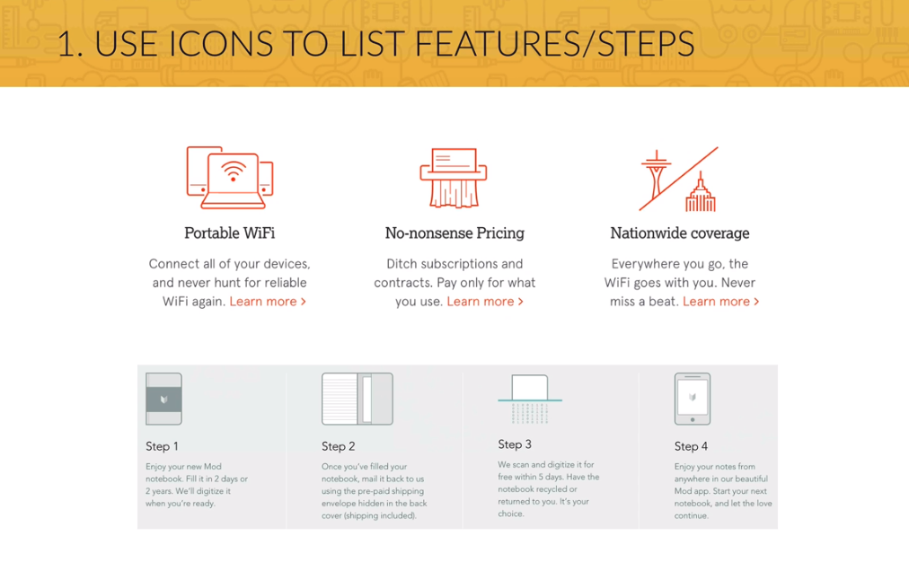
14. Icons

Slide 74
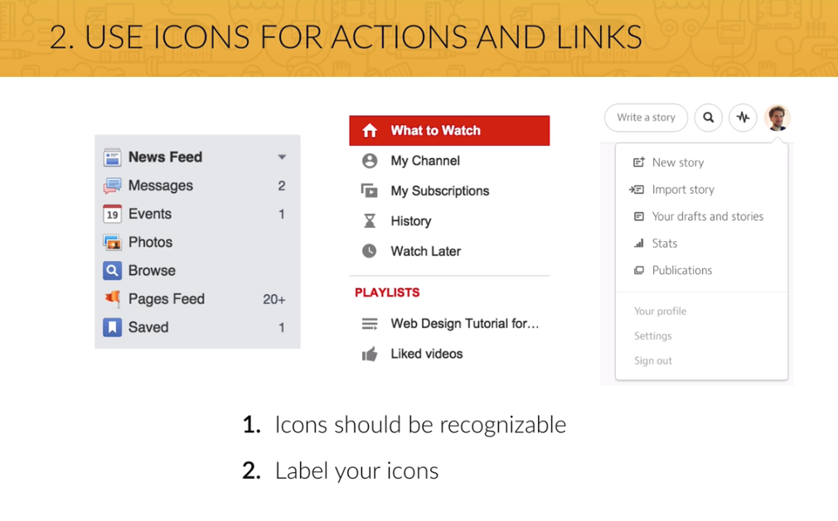
14. Icons

Slide 75
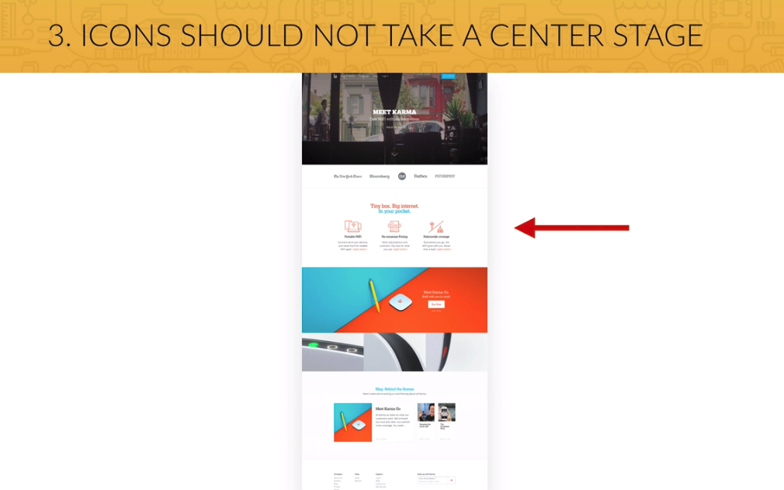
14. Icons

Slide 76
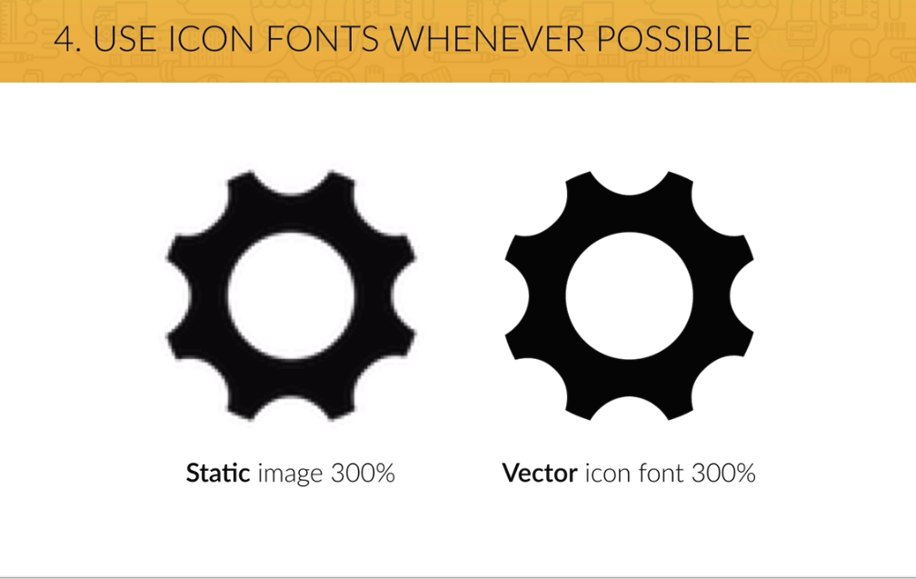
14. Icons

Slide 77
Summary
Most of your content will be text, so beautiful typography is a key element to a good looking website.
Images are getting more and more important in webdesign, so choosing great images and putting text on them is an essential part of your work.
Icons are also a good way of setting a friendly tone for your website, but use them carefully.
The adequate use of whitespace makes a website look professionally designed, so use it a lot, but in the correct way.
Build a layout by defining the visual hierarchy of your content. Whitespace is also important for this.

